Slide 1


Name:- Janmejaya Pharande
Date:- 16/04/2023

Slide 2
Outline
Executive Summary
Introduction
Methodology
Results
Conclusion
Appendix
2

Slide 3
Executive Summary
Summary of methodologies
Data Collection through API
Data Collection with Web Scraping
Data Wrangling
Exploratory Data Analysis with SQL
Exploratory Data Analysis with Data Visualization
Interactive Visual Analytics with Folium
Machine Learning Prediction
Summary of all results
Exploratory Data Analysis result
Interactive analytics in screenshots
Predictive Analytics result
3

Slide 4
Introduction
The goal of this project is to develop a machine learning pipeline that can predict the probability of a successful landing of the first stage of a Falcon 9 rocket. The successful landing of the first stage is crucial for reducing the cost of rocket launches, as Space X can reuse the first stage. Therefore, understanding the factors that contribute to a successful landing is critical for predicting launch costs accurately and developing a competitive bidding strategy for rocket launch services.
To achieve this goal, we need to identify the critical features that affect the landing of the first stage. These features may include environmental conditions, such as wind speed and direction, sea state, and visibility, as well as technical factors, such as the performance of the engines, the guidance system, and the control systems.
Problems you want to find answers
What factors determine the successful landing of the Rocket?
Developing an accurate machine learning model for predicting the success rate of a first-stage landing.
iii.
What operating conditions needs to be in followed to have a successful landing flight.
4

Slide 5

Section 1
5

Slide 6
Methodology
Executive Summary
Data collection methodology:
Describe how data was collected
Perform data wrangling
Describe how data was processed
Perform exploratory data analysis (EDA) using visualization and SQL
Perform interactive visual analytics using Folium and Plotly Dash
Perform predictive analysis using classification models
How to build, tune, evaluate classification models
6

Slide 7
Data Collection
Data collection methods: Data was collected using get requests to the SpaceX API and web scraping from the Internet.
Converting data to Pandas DataFrame: The response content was decoded as a JSON and then
converted into a Pandas DataFrame using .json_normalize() function call.
Data cleaning: The data was cleaned and checked for missing values. Missing values were filled in where necessary.
Web scraping: We used BeautifulSoup to extract the launch records as an HTML table from
Wikipedia, parsed the table and converted it to a Pandas DataFrame for analysis.
Objective: The objective of data collection and cleaning was to develop a robust dataset that can be used for analysis and developing a machine learning model for predicting the success rate of a first-stage landing.
7

Slide 8

Data Collection – SpaceX API
We used the get request to the SpaceX API to collect data, clean the requested data and did some basic data wrangling and formatting.
The link to the notebook is https://github.com/Janmejaya03/ janmejayapharandecapstonestory
/blob/main/janmejaya-spacex-
data-collection-api.ipynb
8

Slide 9
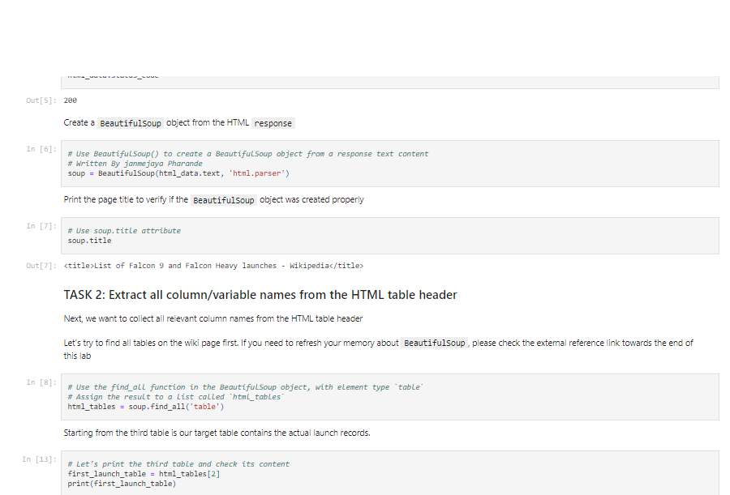
Data Collection - Scraping
We applied web scrapping on webscraping Falcon 9 launch records using BeautifulSoup
We prepared the table and converted it into a pandas dataframe.
The link to the notebook is https://github.com/Janmejaya03/janmeja yapharandecapstonestory/blob/main/jan mejaya-webscraping.ipynb
9

Slide 10

Data Wrangling
Exploratory Data Analysis (EDA) was conducted to gain insights into the data. This involved analyzing various aspects of the data, such as the number of launches at each site and the occurrence of different orbits.
Training labels were determined through the EDA process. This involved identifying patterns and trends in the data, which were used to label the data for the purpose of machine learning.
The resulting data was exported to a CSV file, which included a landing outcome label that was derived from the outcome column. This file can now be used for further analysis and machine learning tasks.
The link to the notebook is https://github.com/Janmejaya03/janmejayapharan decapstonestory/blob/main/janmejaya-data- wrangling.ipynb
10

Slide 11
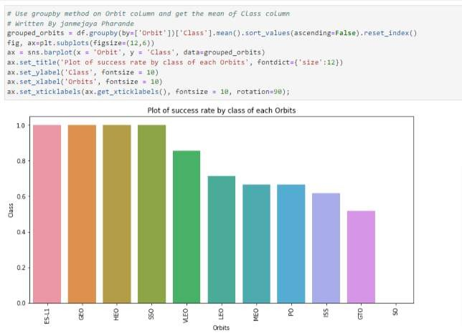
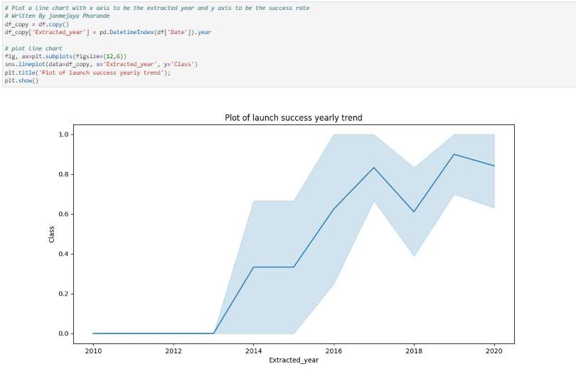
EDA with Data Visualization
We explored the data by visualizing the relationship between flight number and launch Site, payload and launch site, success rate of each orbit type, flight number and orbit type, the launch success yearly
The link to the notebook is https://github.com/Janmejaya03/janmejayapharandecaps tonestory/blob/main/janmejaya-eda- visualization.jupyterlite.ipynb
11

Slide 12
EDA with SQL
We loaded the SpaceX dataset into a PostgreSQL database without leaving the
jupyter notebook.
We applied EDA with SQL to get insight from the data. We wrote queries to find out for instance:
The names of unique launch sites in the space mission.
The total payload mass carried by boosters launched by NASA (CRS)
The average payload mass carried by booster version F9 v1.1
The total number of successful and failure mission outcomes
The failed landing outcomes in drone ship, their booster version and launch site names.
The link to the notebook is https://github.com/Janmejaya03/janmejayapharandecapstonestory/blob/main/janm ejaya-EDA-with-SQL.ipynb
12

Slide 13
Build an Interactive Map with Folium
Launch sites were marked and map objects such as markers, circles, and lines were
added to a Folium map to visualize the success or failure of launches for each site.
This helped to identify patterns and trends in the data that could be used to make predictions about future launches.
Launch outcomes were assigned to classes 0 and 1, where 0 represents failure and 1 represents success. This allowed for easy classification and analysis of the data.
Using the color-labeled marker clusters, high success rate launch sites were
identified. This information can be used to inform decisions about where to focus resources for future launches.
Distances between launch sites and their proximities were calculated, which helped
to answer questions such as which launch sites are closest to each other, and which
launch sites are most suitable for certain types of missions. This information can be used to optimize launch strategies and reduce costs.
Are launch sites near railways, highways and coastlines.
Do launch sites keep certain distance away from cities.

Slide 14
Build a Dashboard with Plotly Dash
We built an interactive dashboard with Plotly dash
We plotted pie charts showing the total launches by a certain sites
We plotted scatter graph showing the relationship with Outcome and Payload Mass (Kg) for the different booster version.
The link to the notebook is https://github.com/Janmejaya03/janmejayapharandecapstonest ory/blob/main/Plotly%20Janmejaya%20code.py

Slide 15
Predictive Analysis (Classification)
The data was loaded and transformed using NumPy and Pandas. The data was then split into training and testing sets to prepare for the machine learning models.
Multiple machine learning models were built, and hyperparameters were tuned using GridSearchCV. This allowed for optimization of the models and improved their accuracy.
Feature engineering and algorithm tuning were used to further improve the model's accuracy. The accuracy metric was used to evaluate the performance of the model and guide the optimization process.
We found the best performing classification model.
The link to the notebook is https://github.com/Janmejaya03/janmejayapharandecapstonestory/blob/mai n/Janmejaya-SpaceX-Machine-Learning.ipynb
15

Slide 16
Results
Exploratory data analysis results
Interactive analytics demo in screenshots
Predictive analysis results
16

Slide 17

Section 2

Slide 18
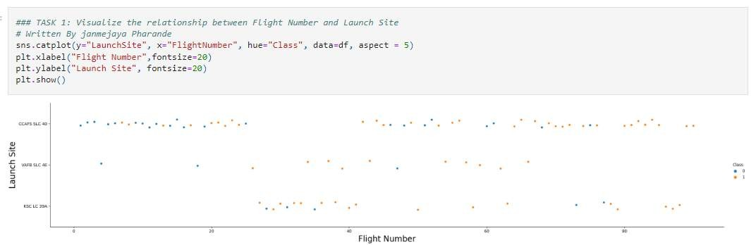
Flight Number vs. Launch Site

Slide 19
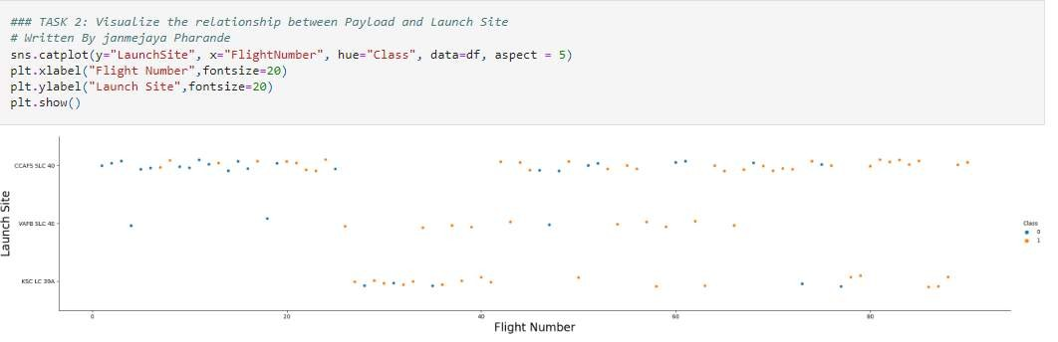
Payload vs. Launch Site

Slide 20
Success Rate vs. Orbit Type

Slide 21
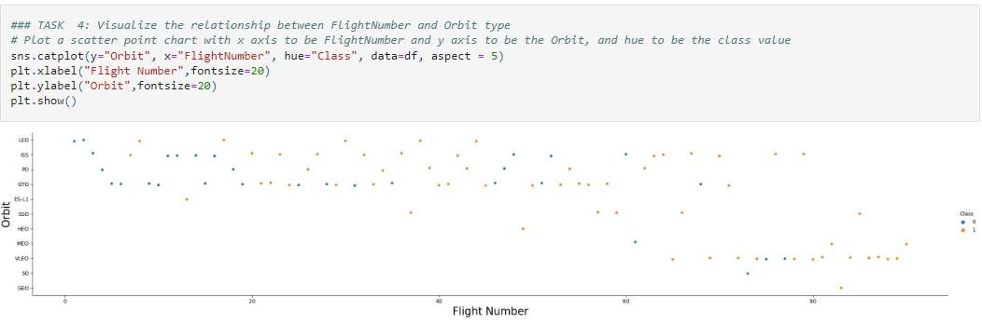
Flight Number vs. Orbit Type

Slide 22
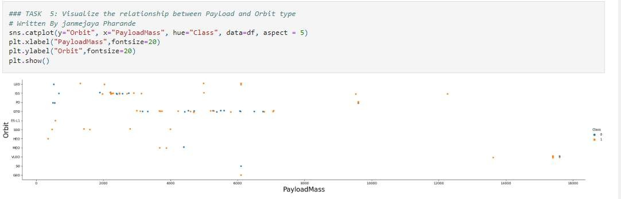
Payload vs. Orbit Type

Slide 23
Launch Success Yearly Trend

Slide 24
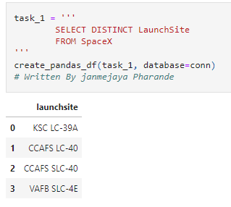
All Launch Site Names
We used the key word DISTINCT to show only unique launch sites from the SpaceX data.

Slide 25
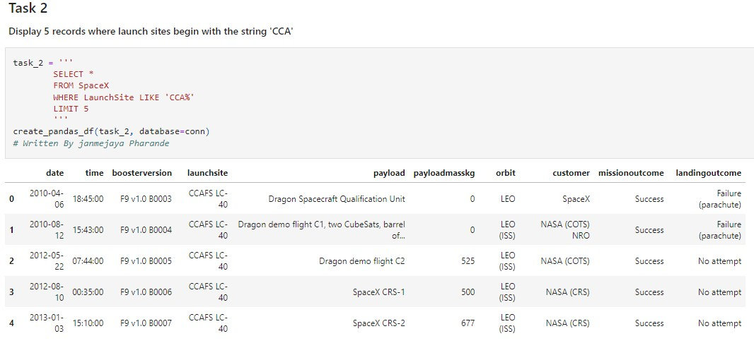
Launch Site Names Begin with 'CCA'

Slide 26
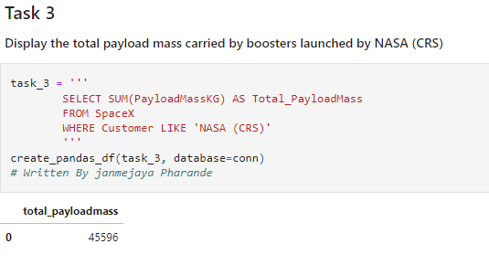
Total Payload Mass

Slide 27
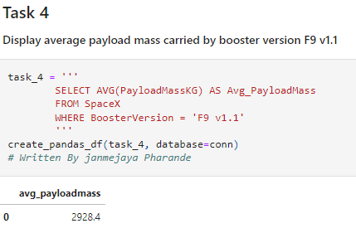
Average Payload Mass by F9 v1.1

Slide 28
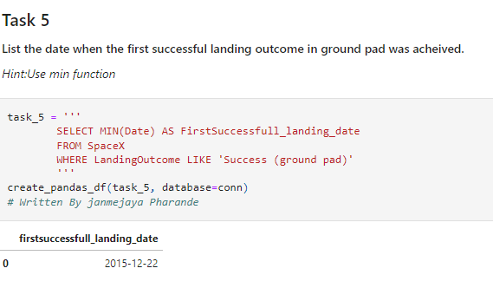
First Successful Ground Landing Date

Slide 29
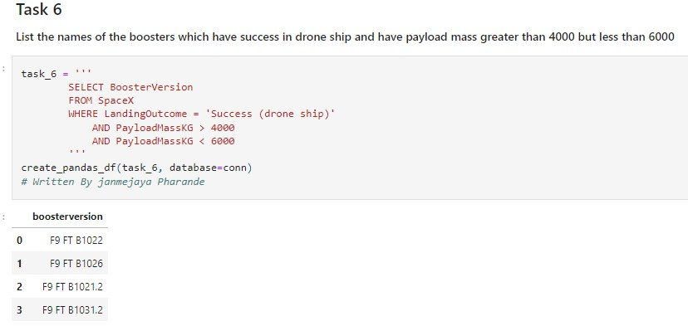
Successful Drone Ship Landing with Payload between 4000 and 6000

Slide 30
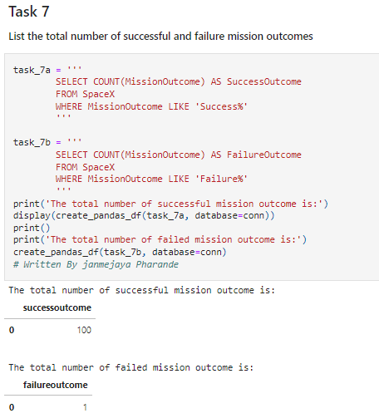
Total Number of Successful and Failure Mission Outcomes

Slide 31
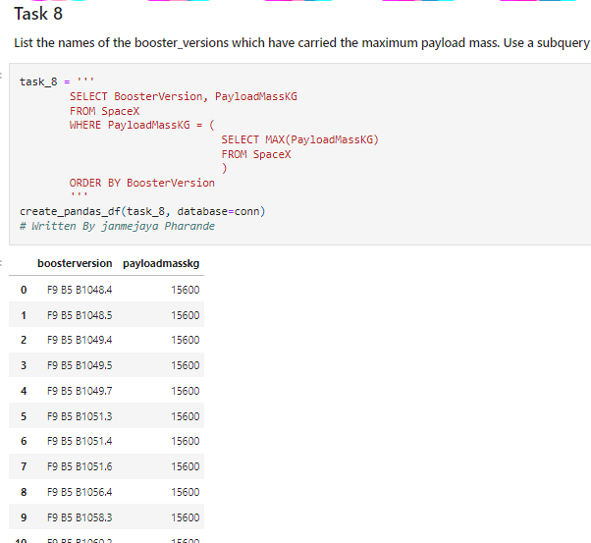
Boosters Carried Maximum Payload

Slide 32
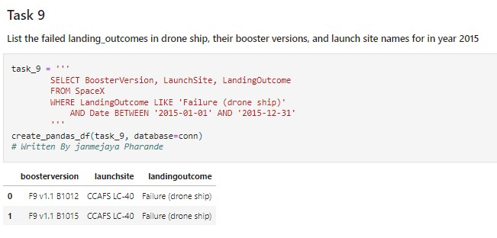
2015 Launch Records

Slide 33
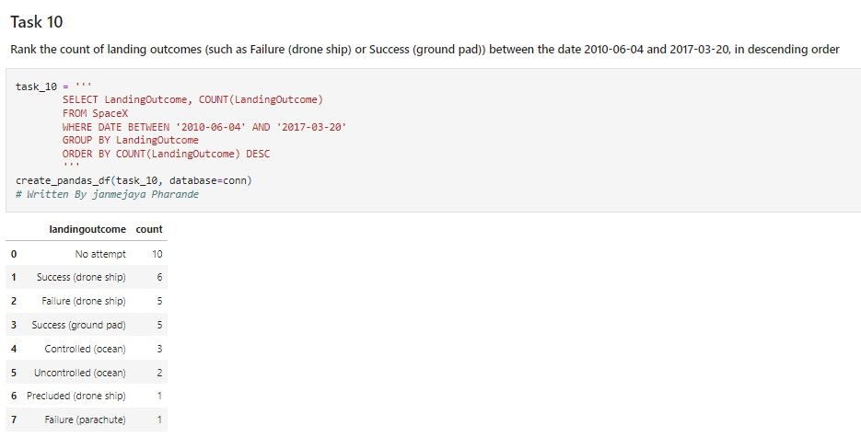
Rank Landing Outcomes Between 2010-06-04 and 2017-03-20

Slide 34

Section 3

Slide 35
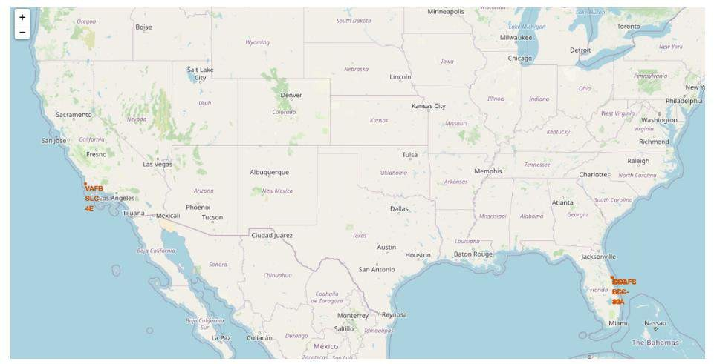
<Folium Map Screenshot 1>

Slide 36
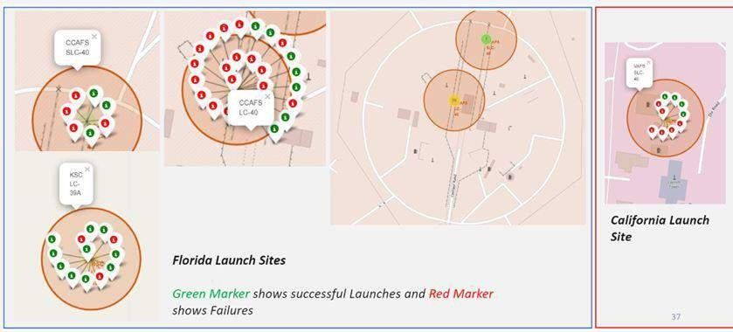
<Folium Map Screenshot 2>

Slide 37
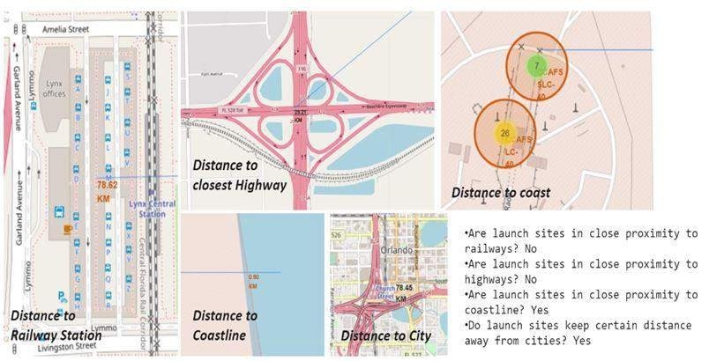
<Folium Map Screenshot 3>

Slide 38

Section 4

Slide 39
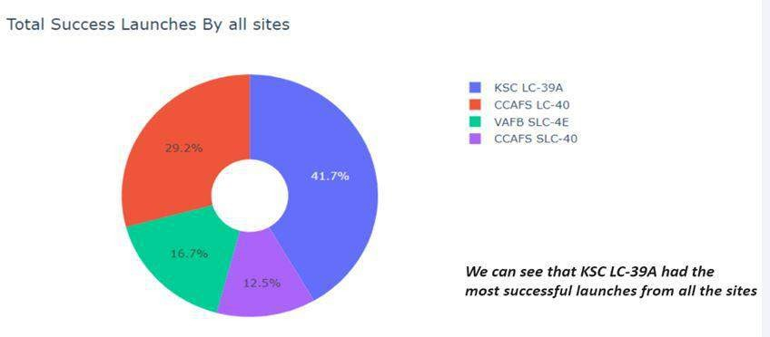
<Dashboard Screenshot 1>

Slide 40
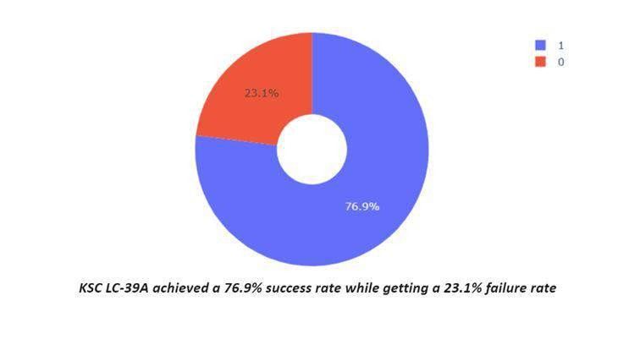
<Dashboard Screenshot 2>

Slide 41
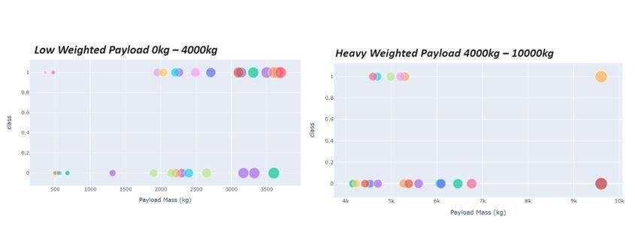
<Dashboard Screenshot 3>

Slide 42

Section 5

Slide 43
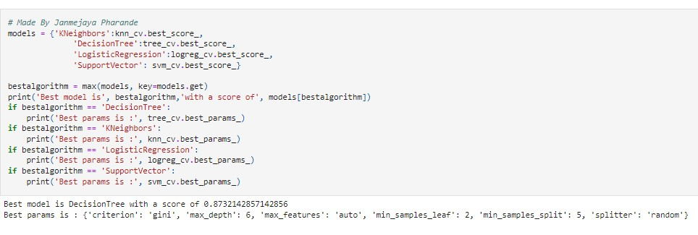
Classification Accuracy

Slide 44
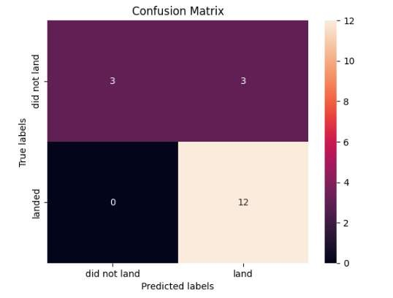
Confusion Matrix

Slide 45
Conclusions
Launch success rate appears to be positively correlated with flight amount at a launch site.
Launch success rates have been increasing steadily from 2013 to 2020.
Orbits such as ES-L1, GEO, HEO, SSO, and VLEO have had the highest success rates.
KSC LC-39A has had the most successful launches compared to any other site.
The Decision tree classifier is considered the best machine learning algorithm for this particular task.

Slide 46


